Slide 1
Harkins Middle School
Meet the Teacher 2016

Slide 2
Agenda:
Welcome
Important HMS information
Our Website/Facebook page
New Report Card
Attendance Policy
Meet and greet

Slide 3
Important Information for Parents:
Harkins Middle School is a closed campus. If your child is being picked up early, they need to be signed out at the main office. If they arrive late, they will need to sign in.
Visitors to the school need to buzz in.
Drop off for students getting a drive to school.
No agendas this year but teams have provided a homework folder that should go home regularly.
When calling for your child’s homework, please call early.

Slide 4
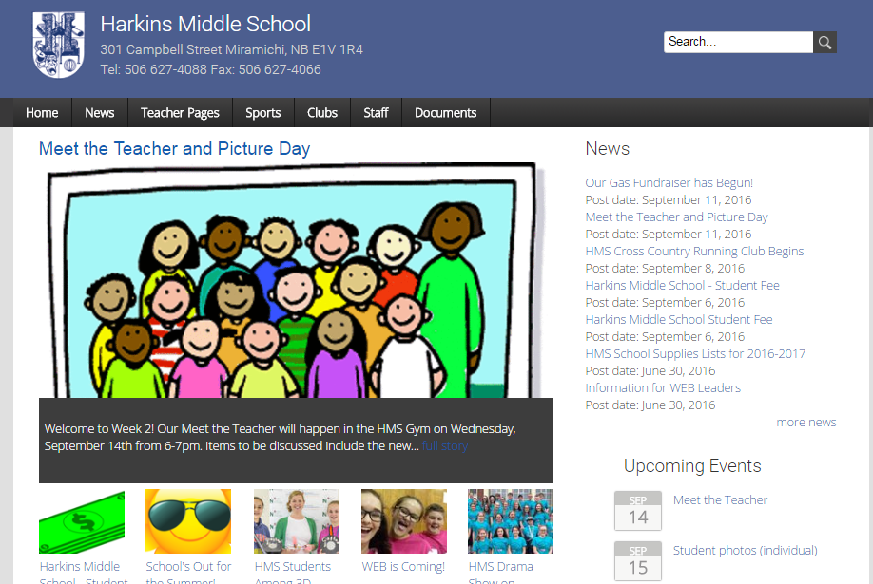
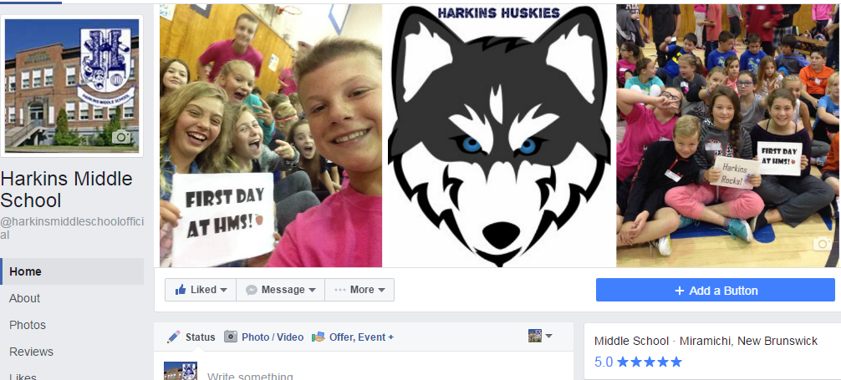
Both sites are updated regularly. It’s a great place to check for homework, important dates, photo galleries, etc.

Slide 5
New Report Card
Notes:
-This is a short presentation to explain the purpose of the changes to the report card and what it will mean to to the parents of your students. Please feel free to add to or omit sections, depending on your audience and time frame.
(It would be a good idea to have your teacher, who gave the assessment/report card professional learning sessions last year on hand to give support for the learning.)
-This session will highlight the changes that have occurred with reporting in our schools. These changes to create a better report card are the result of research, and consultation with educators and parents.

Slide 6
Purpose for developing a New NB Report Card
Reflect and support the changes in classroom assessment practices.
Create a report card that reveals how a student is performing and progressing in terms of curricular outcomes and standards.
Overall, provide an improved communication tool that is much more informative than a traditional letter grade or mark.
Improve consistency of the reporting practices within New Brunswick schools.
Notes:
We need a straightforward reporting system that is accurate, meaningful, and supportive of learning. Parents and teachers feel it is important that report cards communicate a true picture of a child’s learning. The new report cards are aligned to the provincial curriculum and the grading scale provides a clear description about what the child knows and is able to do, in terms of the learning goals.
A good report card prompts us to stop at set times and decide if our children are developing good work habits and learning what they are supposed to be learning. This is also the time to identify if we need to take additional action.
We want every report card to provide clear, consistent and accurate information so all of our students have the opportunity to realize their full potential.
The new report card ensures that we are consistent across grade levels as this supports learning, reduces confusion for students and parents, and eases transition from one grade to the next.

Slide 7
Highlighting the Structural Changes
There will be three reporting periods (November, March, and June).
Two parent teacher interview days will be scheduled matching the November and March report cards.
Comment sections will focus on students’ strengths, needs, and next steps.
Notes:
Strengths, Needs, and Next Steps will be included with each subject- This will give the parents more information about what their child is doing well, what they need to work on, and where they are going next in their learning.
The Learning Habits- We need to separate the reporting on progress, achievement, and behavior. Currently, all these things are rolled into one grade which makes it difficult for a parent to know if their child is actually meeting the learning goals, or if they’re just trying really hard, or even if they’re just really cooperative
PLP- Personalized Learning Plan and EAL- English as Another Language
Response Form- Parents are encouraged to discuss the report card with their child and send in the response form to the school. This replaces the report card envelope where parents could respond to the report.

Slide 8
Highlighting Changes in Assessment Practices
Each reporting period stands alone.
Strands will now be assessed. There is no overall grade by subject.
Curriculum rubrics will be used to describe the levels of performance and clear assessment targets.
Assessment of outcomes/standards will be done on a four point scale with 4 being the highest.
There is an option to give students a 4+ or 3+.
The key words connected to these four levels are:
4 Excelling (4+ surpasses)
3 Meeting (3+ consistently)
2 Approaching
1 Below
Notes:
-Each reporting period stands alone. There is no averaging of marks. We need to separate out the skill areas within subjects to provide information about how well a student is meeting learning goals in the skills areas.
For example, in English Language Arts, children are taught speaking, reading, and writing skills. One overall grades does not provide enough information for students, parents or for teachers in upcoming grades.

Slide 9
Descriptors for Writing Report Card Comments
4 Demonstrates required knowledge and skills and is excelling with learning goals. (4+ surpasses expectations)
3 Demonstrates required knowledge and skills, and is meeting learning outcomes. (3+ consistently proficient achievement)
2 Demonstrates some of the required knowledge and skills, and is approaching learning goals
Demonstrates limited understanding of the required knowledge and skills and is working below learning goals.
Notes:
-4 point scale- Emphasize that this does not translate from the letter grades. 4+ is not the new A+. 4+ indicates that the child is achieving above grade level. The example from EECD is a grade 7 student who would score a ‘strong’ on the grade 9 ELPA on a writing piece.
-There is a long-standing tradition of reporting grades with percentages or letters. Although these seem precise, educators who look closely at assessment, know that these old grading systems are problematic.
-For example, if you went to the doctor for a physical and he/she told you that you have a B+ or an 85, what would you make of that? On the other hand what if he told you your blood pressure, pulse rate, cholesterol level etc.?
-Which information gives you a better picture of your health and what you may need to do?
-What if the doctor averaged all the numbers? That complicates things even more! And makes it hard to understand the condition of your health and what you need to do. Getting one grade for a subject area is similar.

Slide 10
Learning Habits
Learning Habits | Observable Indicators
Independence | -Sets goals and reflects on goals -Asks for assistance when needed -Does not give up easily
Initiative | -Has the desire to learn -Works hard and makes an effort -Takes risks
Interactions | -Resolves conflict appropriately -Works well with others -Is respectful
Organization | -Creates and follows a plan -Manages time well to complete tasks -Manages personal belongings and learning materials
Responsibility | -Takes care of belongings and school property -Completes work on time -Accepts responsibility for actions and manages own behavior
Reporting Scale for Learning Habits
C- Consistently | Almost all of the time
U- Usually | More than half the time
S- Sometimes | Less than half of the time
R- Rarely | Almost never or never
Notes:
Learning Habits have been identified as key areas which support success in learning and in life. The same habits will be featured in K-8 to help students in their personal goals. Expectations for each habit will increase with development and maturity. This consistency is intended to support growth and to emphasize the importance of these habits. These habits will be evaluated using the scale: Consistently, Usually, Sometimes, and Rarely.

Slide 11
Triangulation of Evidence: The Three Components
Notes:
1-3 pieces of evidence for each learning standard (big idea) Over time! Reason – adds validity and reliability (high quality professional judgements
Culminating tasks – not first attempts

Slide 12
Value of Triangulation
Validity - evidence from multiple sources over time
Reliability – repeatability
Guiding question – Does my evidence match what needs to be learned?
Criteria must be clear to all
Notes:
Answers the question- Why triangulation of evidence?

Slide 13
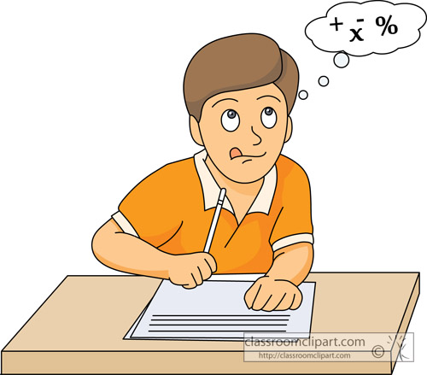
Triangulation of Evidence
Products / Performance
Products are tangible materials created by students that teachers use for assessment purposes.
Traditionally teachers have used these exclusively to assess students.
Products are ONLY one of three types of assessment evidence
Observations
A teacher will watch and assess a student’s action
Some learning can only be observed
Some students are better at showing
Ensure there is a purpose
Conversations
A teacher will listen to the learner and assess the learning based on the discussion
This can be face-to-face or in writing

Slide 15
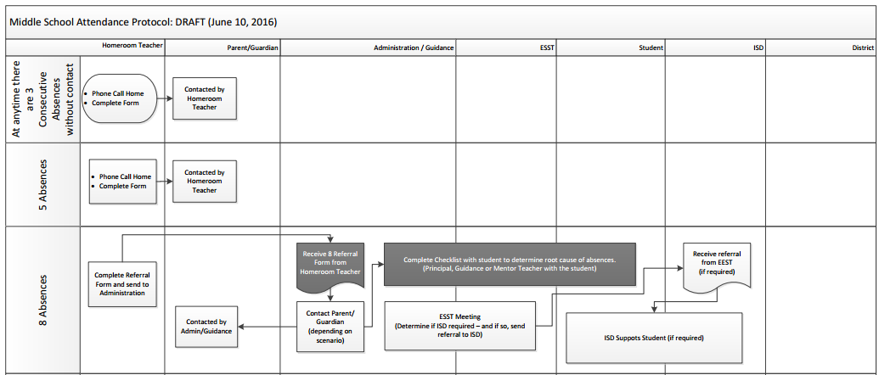
Student Attendance Policy

Slide 16
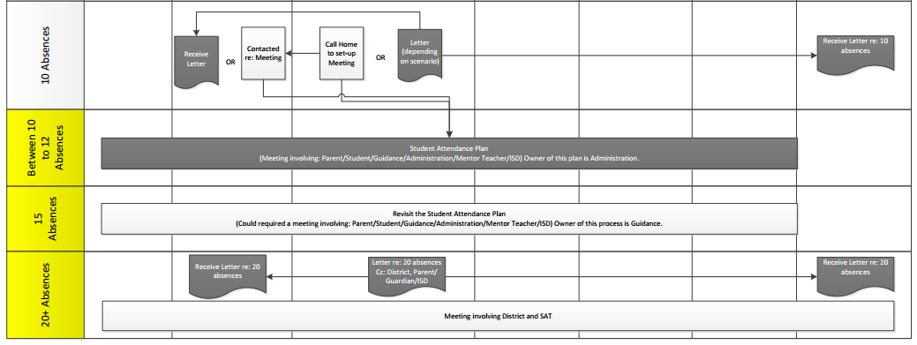

Slide 17
Thank you!
Questions?
Notes:
This is an opportunity to ask questions that may not have been answered in the presentation
If you are unsure, please record questions and email to Joan MacMilllan.

