Slide 1
Pastimes: Hockey
Bradley jardine

Slide 2
Hockey is a very good past time because you never know what can happen. Hockey is important in Canada because it lets you play something fun with your friends and meet new people.

Slide 3
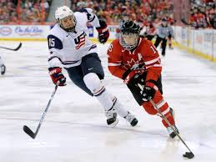

Slide 4
Parents who are watching their children play hockey get to make new friends with the other hockey parents. Hockey is great exercise to keep you healthy.

Slide 5
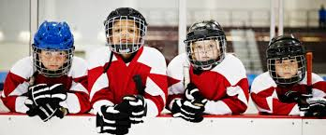
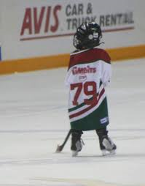

Slide 6
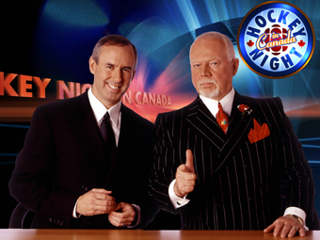
Even if you do not play hockey you can still watch hockey on tv. One night it is on is Saturday when we all come to watch it all together.

Slide 7
When the Olympics was on it was a good time because we saw how Canada represented us. USA was not too happy

Slide 8
So I just told you that hockey is a huge part of Canadian Culture. Many young Canadians dream of becoming a famous hockey player and one day playing for the NHL and representing Canada.

Slide 10
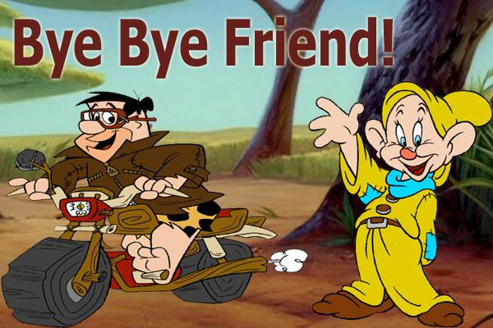
Thank you for listening to my project.

