Slide 1
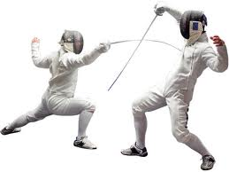
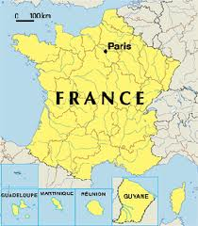
Fencing
By: Lyndsay Jay- Keating

Slide 2
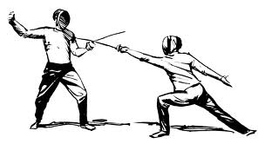
L'escrime est très populaire en France!

Slide 3
Fencing is one of four sports which have been featured at every one of the modern Olympic Games.
Fencing involves two competitors stabbing at each other with different types of swords. The competitors wear protective equipment that prevents injuries.
Fencers win competitions by scoring strikes on different parts of the body, simulating sword fighting.
The earliest evidence of fencing as a sport comes from a carving in Egypt, dating back to about 1200 B.C.
Fencers have three minutes to score their hits. An Olympic fencing competition is ended as soon as a fencer scores 15 strikes.

Slide 4
Fencing rules
Valid target (everything from the waist up, including the arms and head, but excluding both hands).

Slide 5
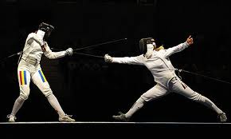
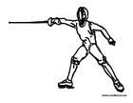
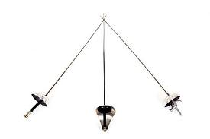
L'escrime est bien plus qu'un simple sport, il est un art!

Slide 6
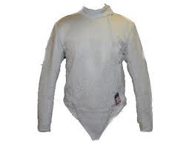
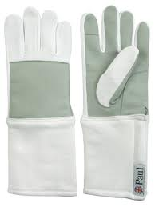
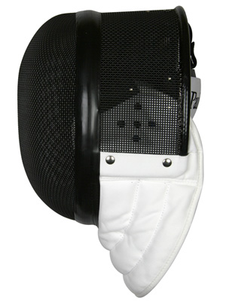
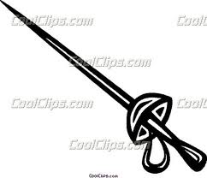
Fencing is very popular in France. The equipment you need are….
gloves
mask
Outfit
sword

Slide 7
LA FIN!!! ☺

